Slide 1
JRuby, a Pi and a Database

Slide 2

Philipp Fehre
Twitter: @ischi
Github: @sideshowcoder
Developer Advocate, Couchbase
Notes:
Ok so who am I
And why
Facinated by Jruby for some time now

Slide 3

It’s just ruby!
Notes:
Using jruby on a mac you have everything already
Install via ruby-build or ruby-install or rvm

Slide 4
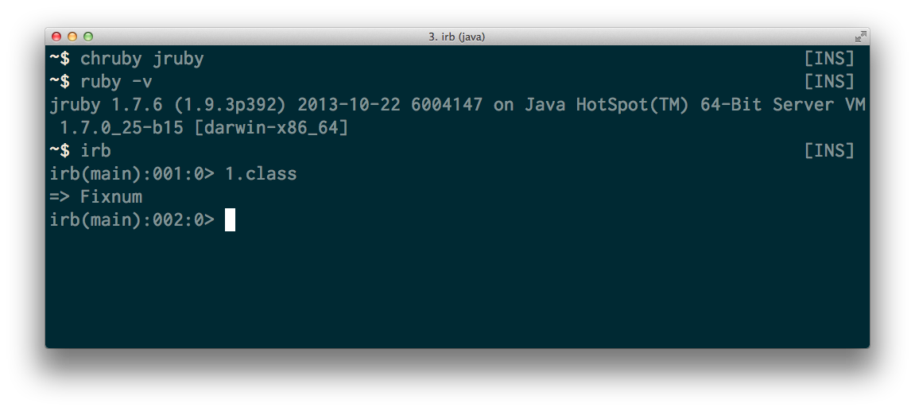
Notes:
All ruby code should just work (Rails, Sinatra etc…)
No support for C extensions
1.9 compatible

Slide 5
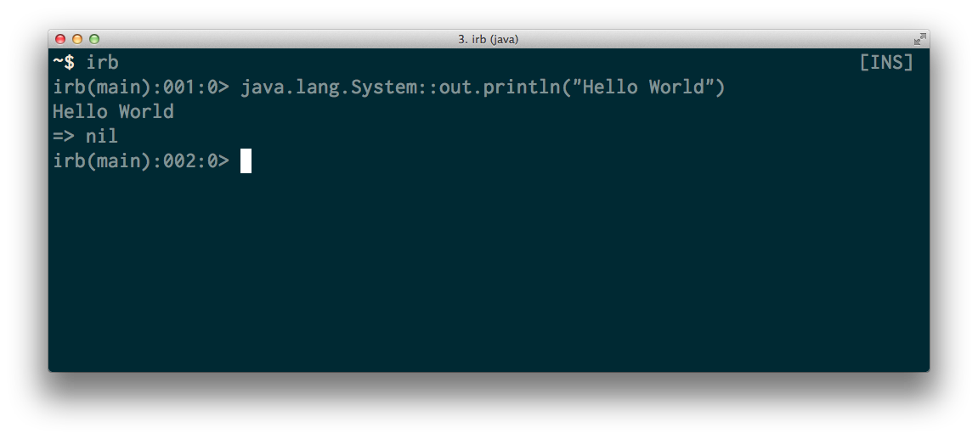
Notes:
You can call native java methods and any java code really
Defaults are under Java namespace or javax .

Slide 6
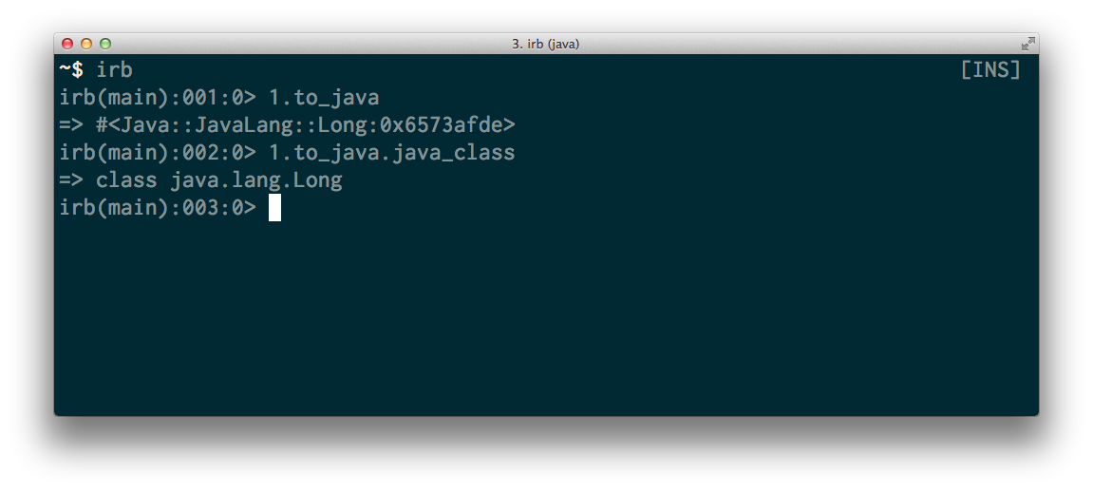
Notes:
Access to lower level Java objects
Sometimes needed to make method calls work

Slide 7
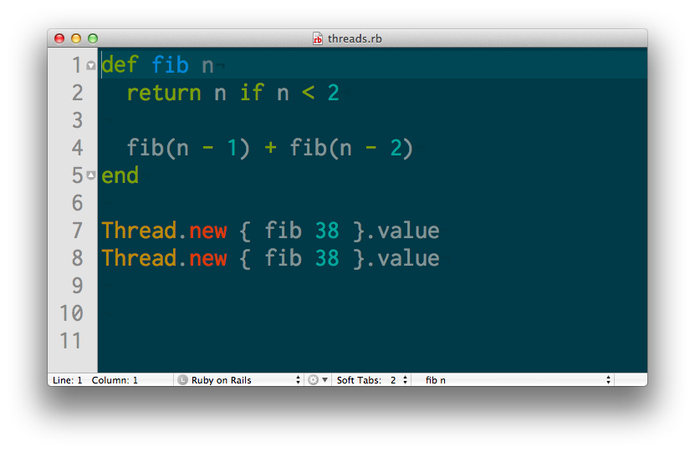
Native threads
Notes:
Ruby code has the GIL
JRuby supports all the Java concurrency stuff
Look in java.util.concurrent for all your concurrency needs (or use the stuff mapped to ruby)

Slide 8
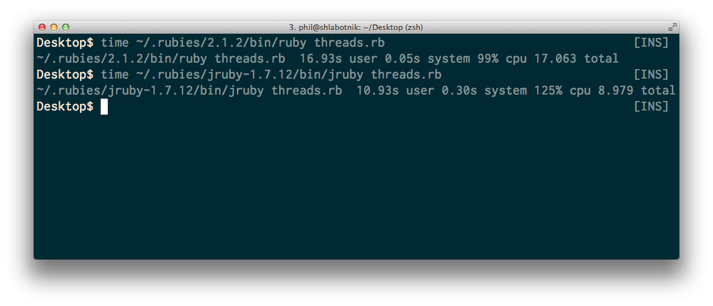
99% vs 125% | 17 sec vs 11 sec
Yes jruby startup time is slow …
Notes:
Ruby code has the GIL, IO is parallel so
JRuby supports all the Java concurrency stuff
Look in java.util.concurrent for all your concurrency needs (or use the stuff mapped to ruby)
Startup time sucks, but can be improved

Slide 9
And more
GC, Java Debugging tools, Java Servers…
Notes:
Visual VM for debugging GC
Bytecode analyzers
Battle tested Java Webservers

Slide 10
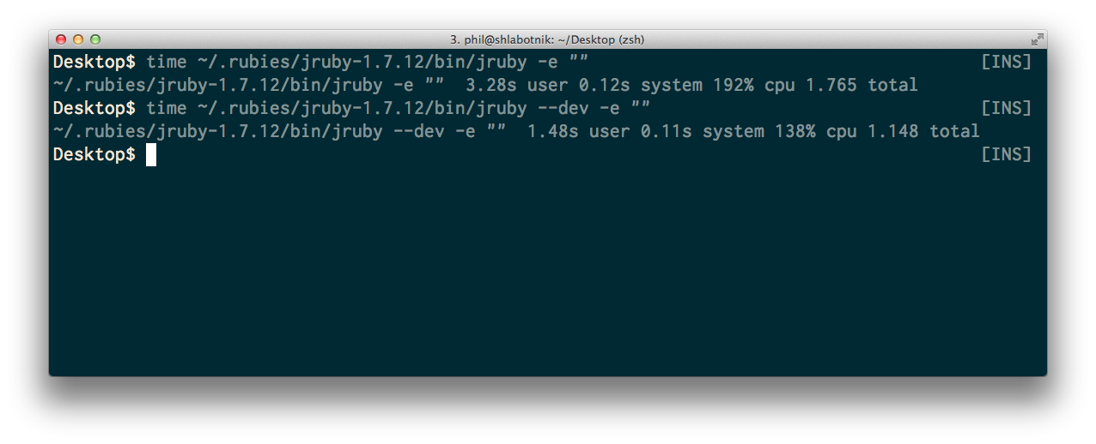
--dev tradeoff performance for startup time
Notes:
No bytecode compile
No invoke dynamic
Less code optimization

Slide 11
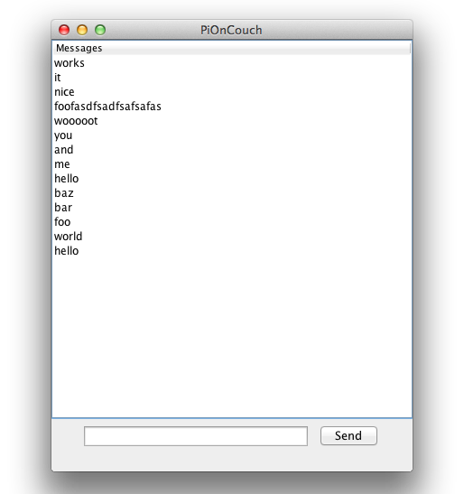
Lets see it in practice
Notes:
This is what we are building
Using Swing + JRuby + CouchbaseLite
Couchbase lite let’s me demo a lot of stuff so

Slide 12
Couchbase Lite
Notes:
Has a native component ( C )
Is using standart Java Idioms
Was originally written for Android (Has a lot of weirdness)

Slide 13
Couchbase Mobil
Couchbase Lite + Sync Gateway
Notes:
Let me tell you a little bit about Couchbase Lite so you know what is being build here
Syncing database for mobile devices
Lets you replicate data between databases
QUICK Demo on Mac and Pi

Slide 14
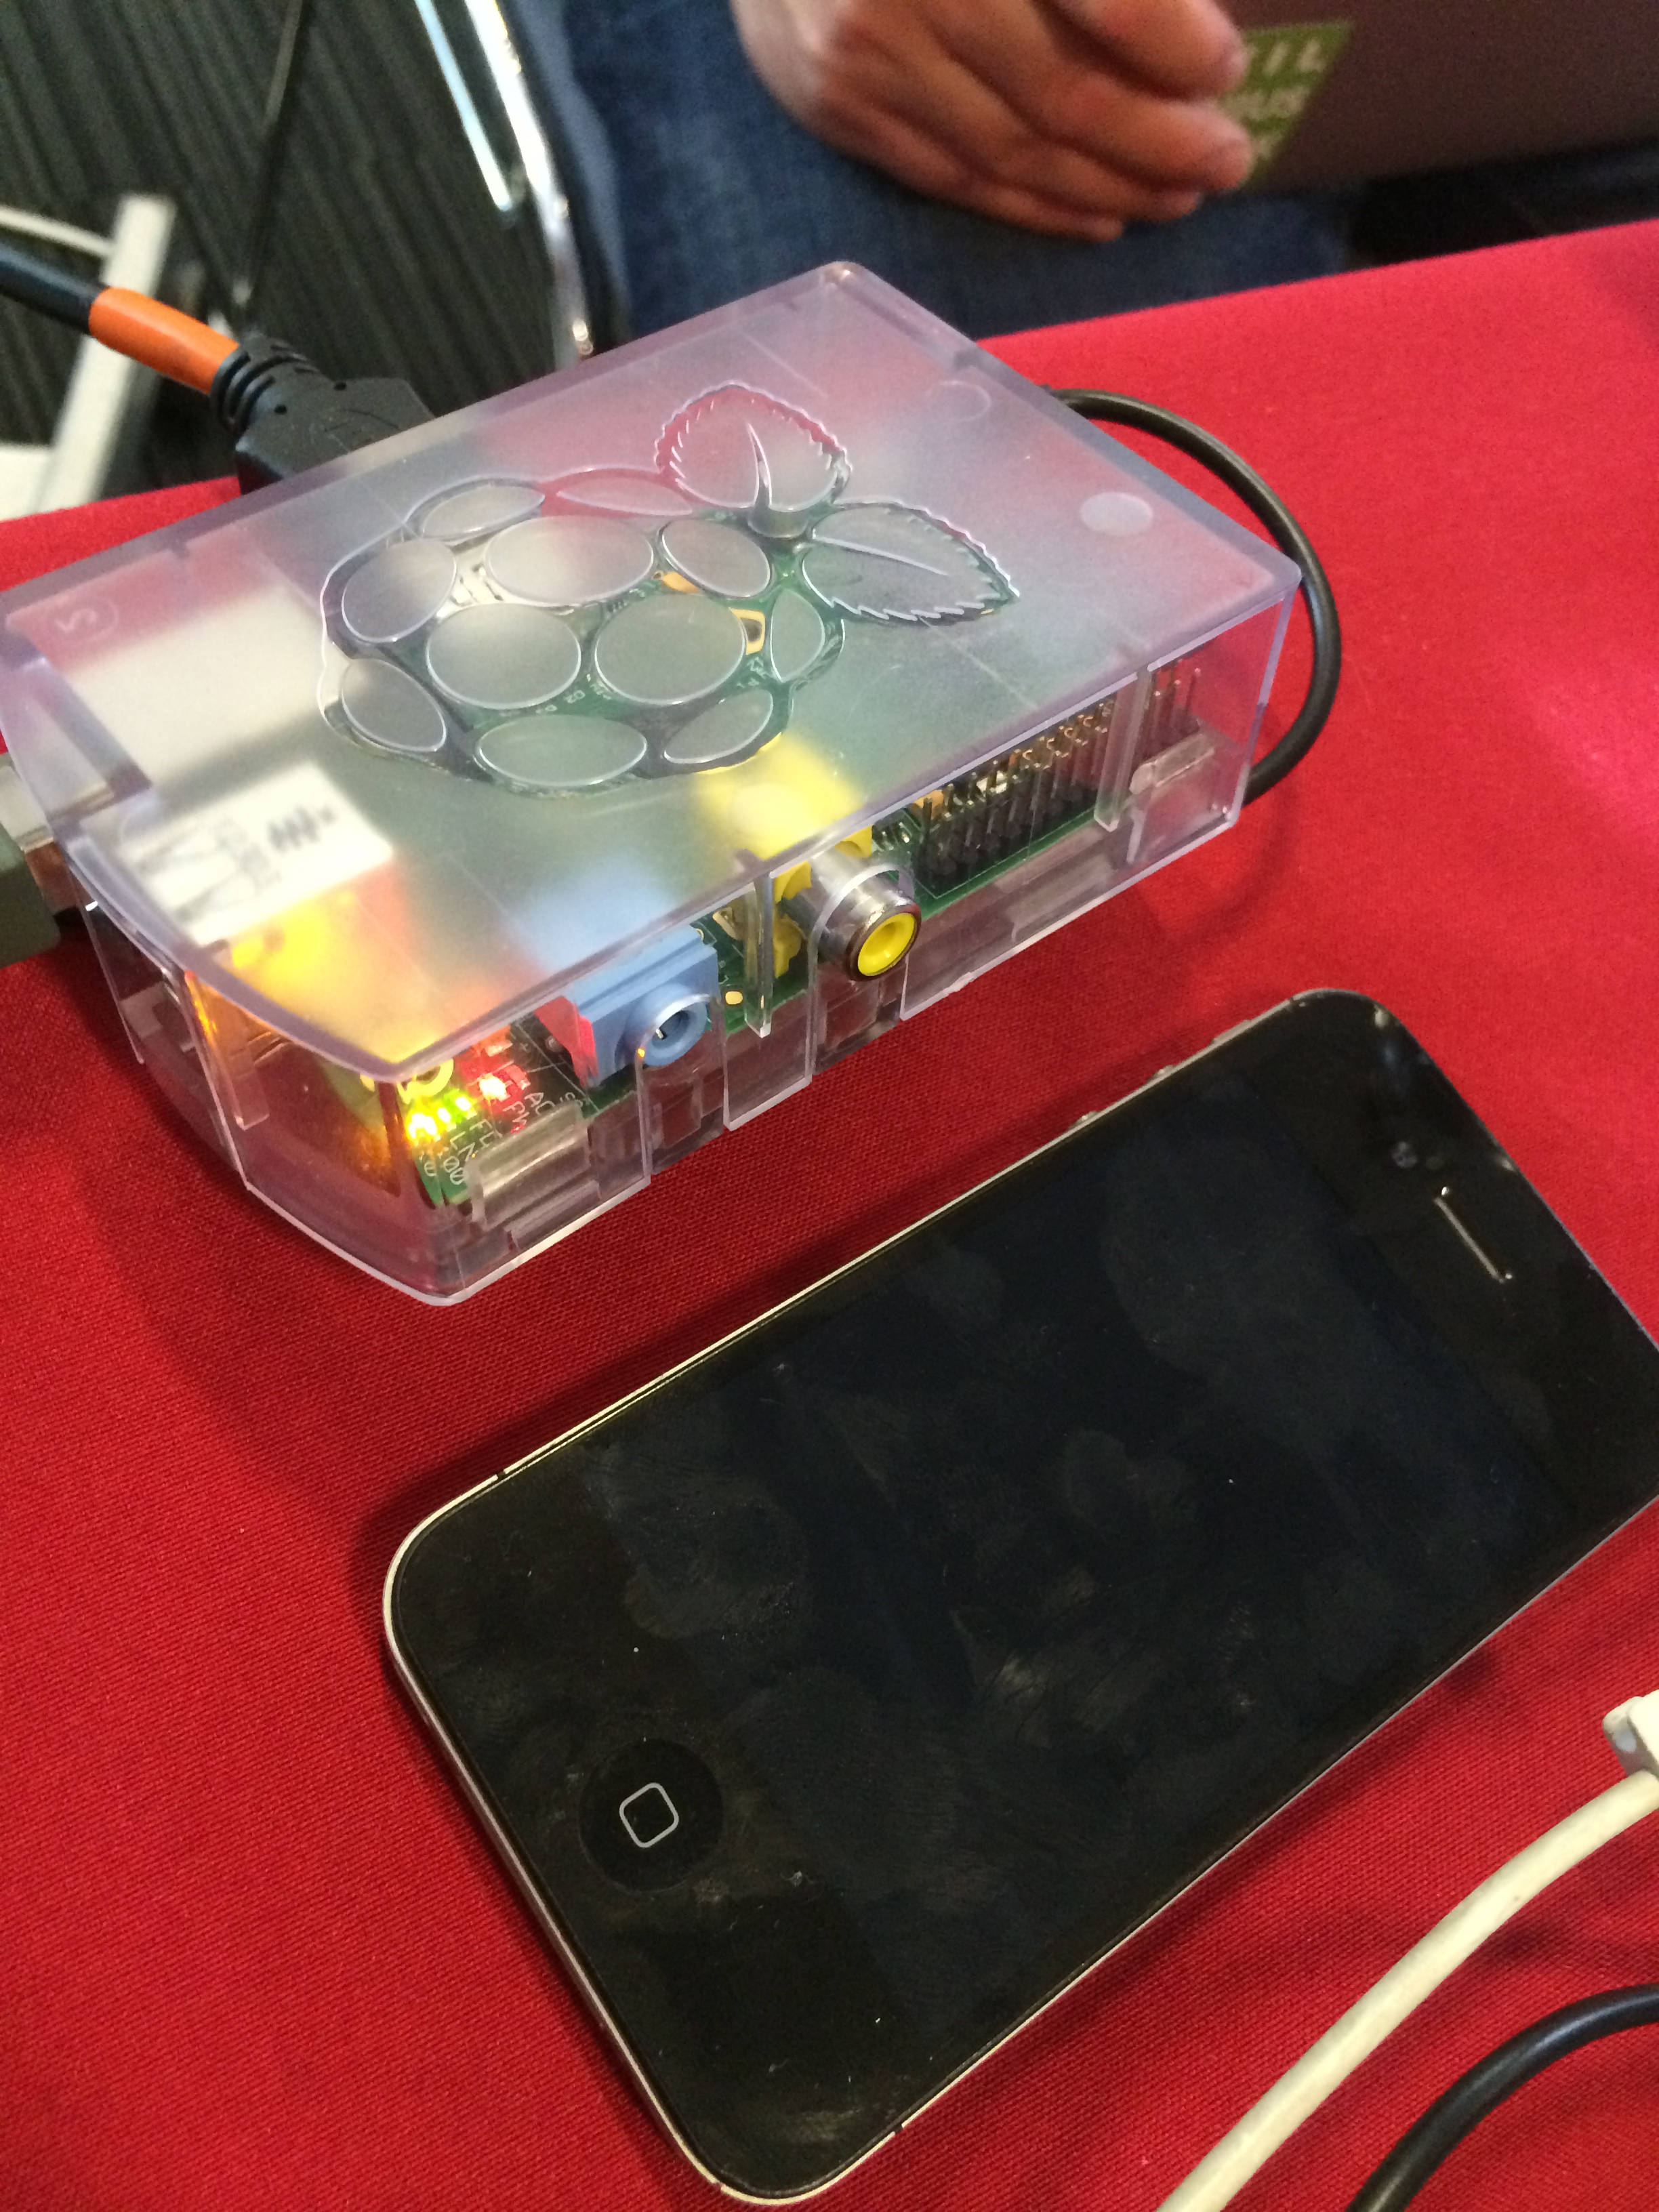
Couchbase Mobil
Couchbase Lite + Sync Gateway
Notes:
Couchbase Mobile is combination of Lite + Sync Gateway
Sync between all kind of devices
Handle authentication
And conflicts

Slide 15
Channels
Tags…

Slide 16
Authentication
Facebook, Mozilla Persona, User + Password, OAuth

Slide 17
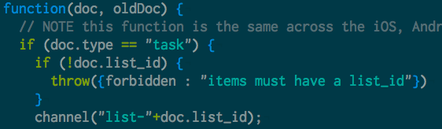
Sync Function

Slide 18
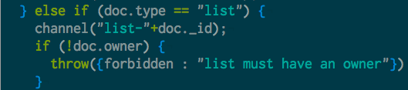
Channels
Notes:
We can have a lot of those (100.000 per instance)

Slide 19
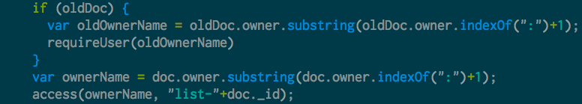
Authentication

Slide 20
Why JRuby?
Notes:
We now know jruby Is cool but…
Why?

Slide 21
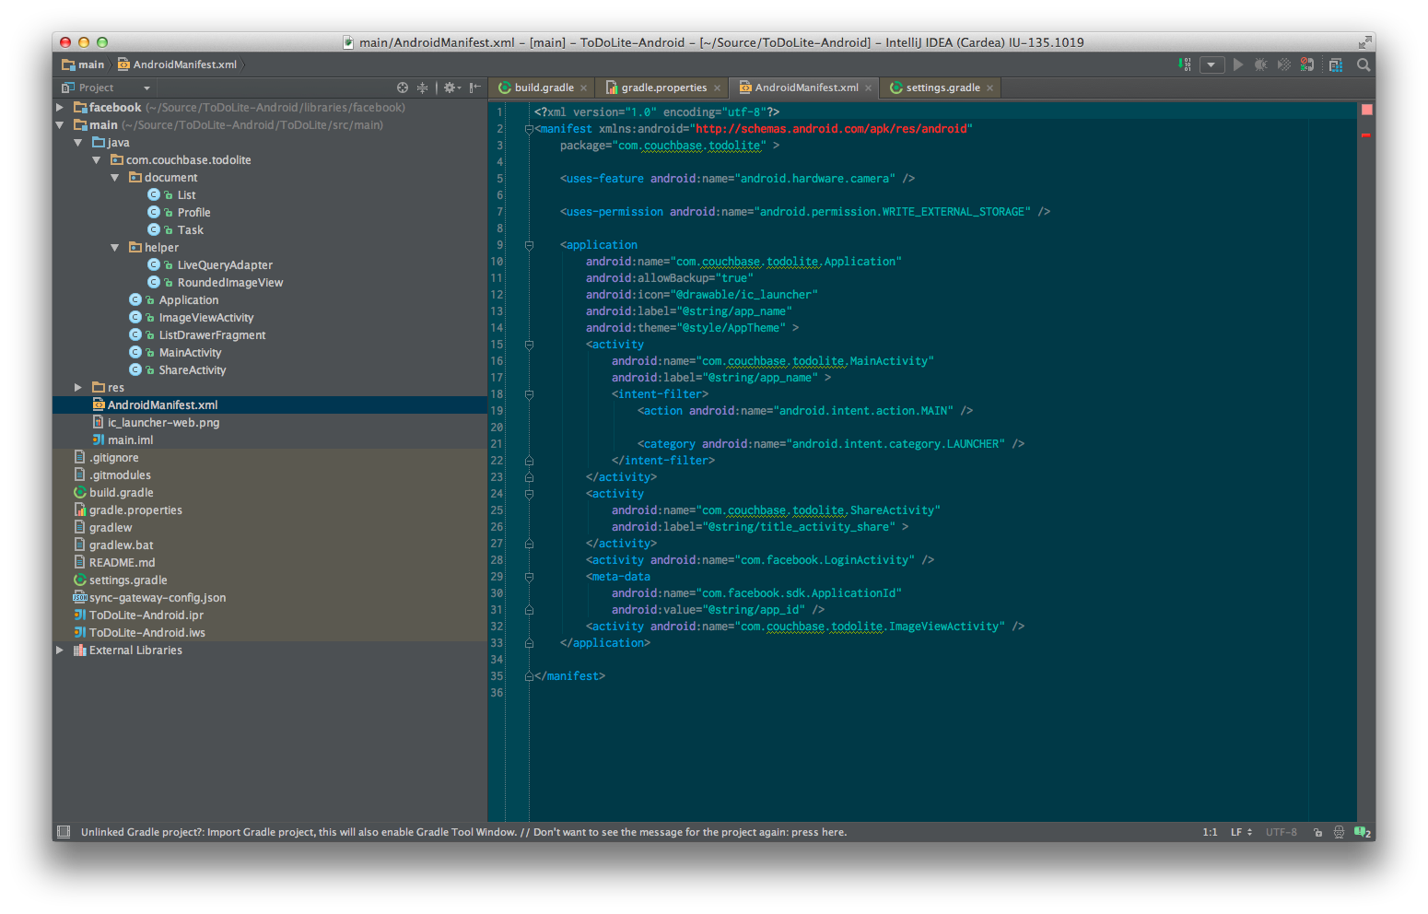
Notes:
Setting up a Java Project can be a lot of work
Especially to try out stuff quickly
Loads of configs +++ don’t need to tell you that

Slide 22
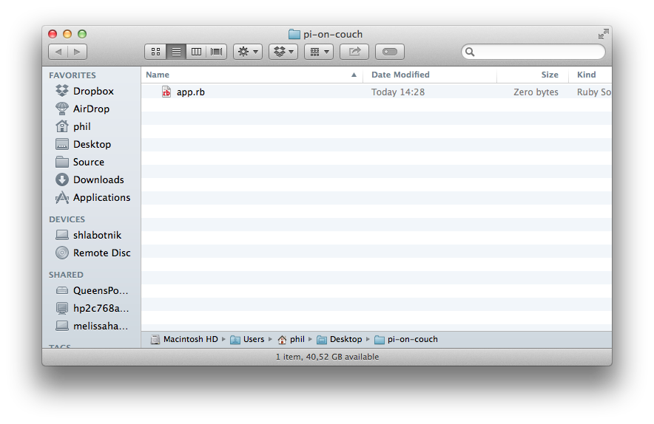
Notes:
Yes this is an unfair comparison
But seriously… Java without project setup basically does not work

Slide 23
Need to call to Java
Java has loads of libraries (like Couchbase Lite) which are only on Java

Slide 24
Pi on Couch
Notes:
- Originally thought JRuby on Pi might be a problem… its not

Slide 25
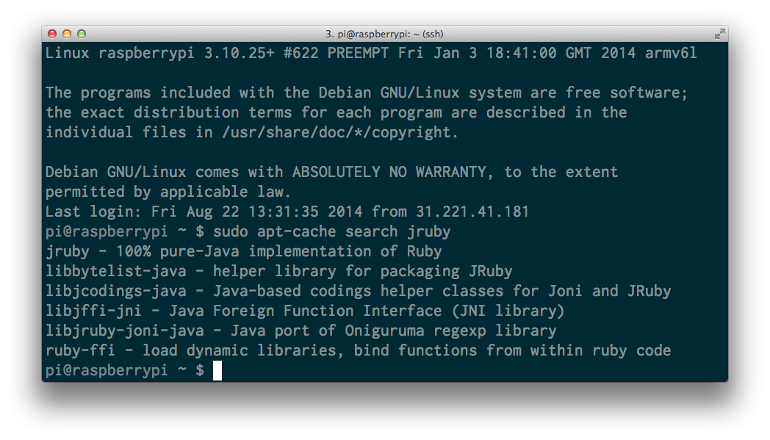
Notes:
- it’s not… just app-get install

Slide 26
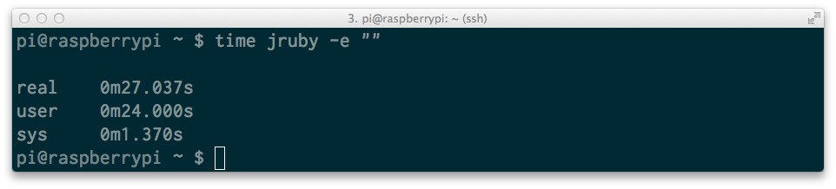
Notes:
it’s just slow
… really slow

Slide 27
Using JRuby
Notes:
So let’s talk about using JRuby and Couchbase
And how this works together

Slide 28
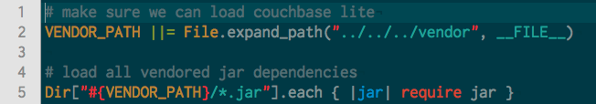
Loading JARs
Notes:
Most of the time you can just require them
Unless they have weird dependencies
If you need to load class files use java_import

Slide 29
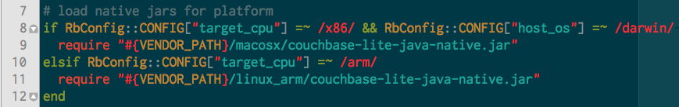
Loading native JARs
Notes:
Works almost the same
Use Ruby runtime to determine the system
This is really nice! Loading stuff at runtime makes this possible

Slide 30
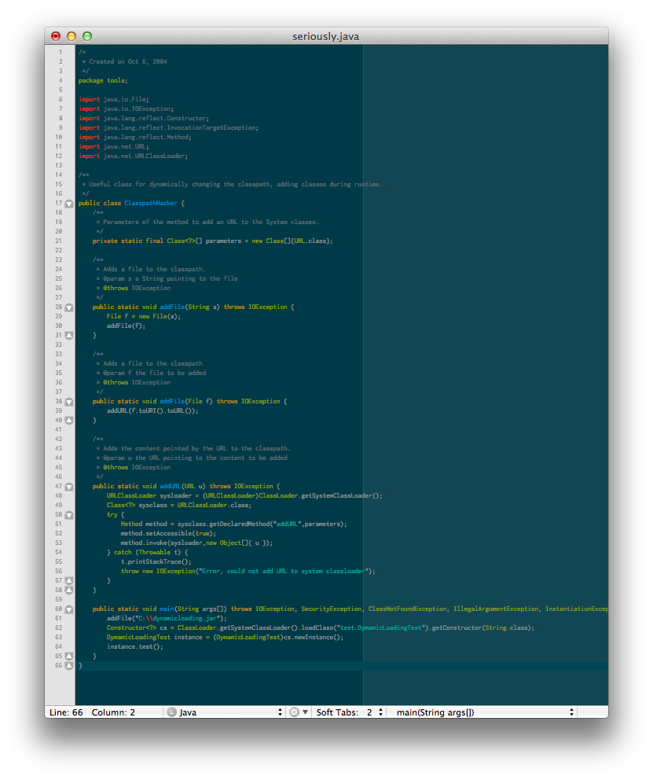
Just for reference… ;)
Notes:
Works in java as well
In just 60 lines of code…

Slide 31
Calling Java Methods
Notes:
If everything is loaded simply call the method
include_package namespaces include in module or class
Import makes it available everywhere, probably better to namespace

Slide 32
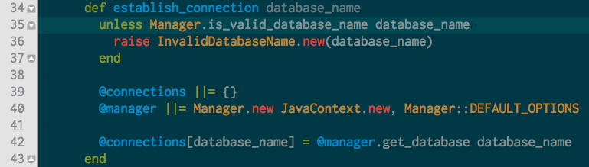
Calling Java Methods
Notes:
Using Java from JRuby feels good
You can just intermix it
And it just works, wrapping the native calls in one location is probably a good idea so
This is the database.rb file, it also has a method to return the connetion

Slide 33
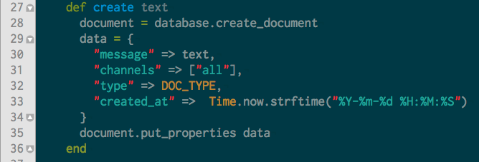
Creating Items in the database
Notes:
Like I said it’s a document database
Just store JSON
Quick note on channels for those interested those are tags for your documents
Ok this covers the basics

Slide 34
Some Java Idioms
in Ruby
Notes:
- To get more we need to talk about some java idioms and how to use them from ruby

Slide 35
Naming
Notes:
Naming things is hard
Java and Ruby have different ways to name stuff
We want to be as Ruby as possible

Slide 36

Setter and Getter
Notes:
- Probably know the getX setX idom

Slide 37
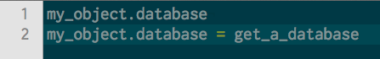
Setter and Getter
Notes:
This maps directly to ruby just using
object.x for getter
Object.x = foo for setter

Slide 38
Setter and Getter
Notes:
Not everything can be mapped so … watch out

Slide 39
Method names
Notes:
- Map between snail case and camel case

Slide 40
Anonymous Classes
Notes:
We see them all the time in API (the new hip thing hey)
There is no direct syntax support in Ruby
We could do it with Class.new but its ugly…
So what do I mean

Slide 41
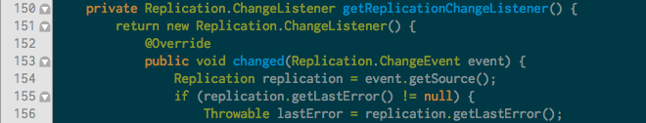
Java
Notes:
Creates a new instance of Replication.ChangeListener() and overrides a method changed
Happens all the time for click handlers or in this case other handlers
This actually monitors the connection so you can react to changes to the database as they happen
Hook in for conflict resolution and so on

Slide 42
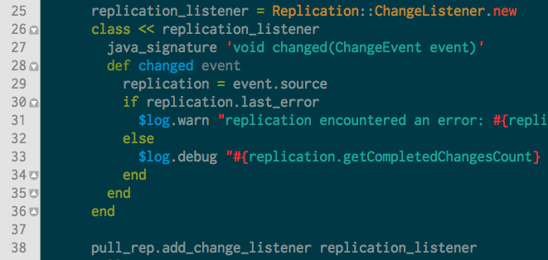
Ruby way number 1
Notes:
Ruby is flexible
Reopen the instance and add a method
Since this is called from java we need to provide the signature so the types match
Opens the eigenclass…

Slide 43
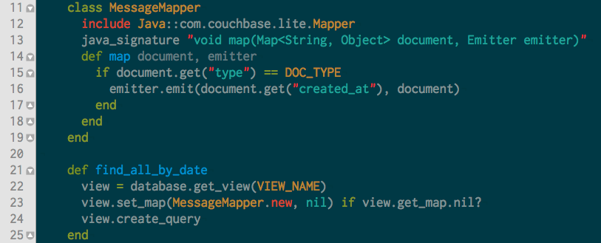
Ruby way number 2
Notes:
Personally I prefer this
Create a class implementing and interface and just use it
Is more straight forward
Classes are cheap… ;)

Slide 44
Generics
They don’t auto convert types

Slide 45
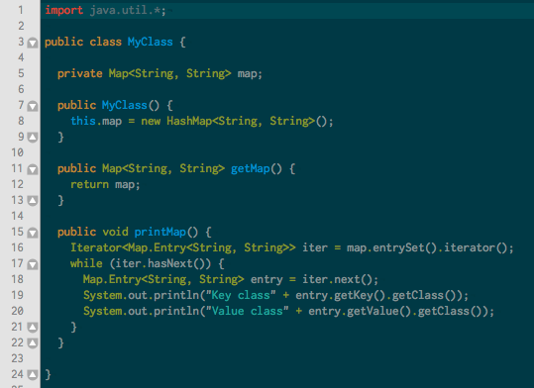
Notes:
One could expect that this converts the types when used from ruby
But it doesn’t

Slide 46
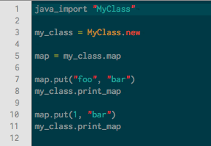
Notes:
When used from ruby

Slide 47
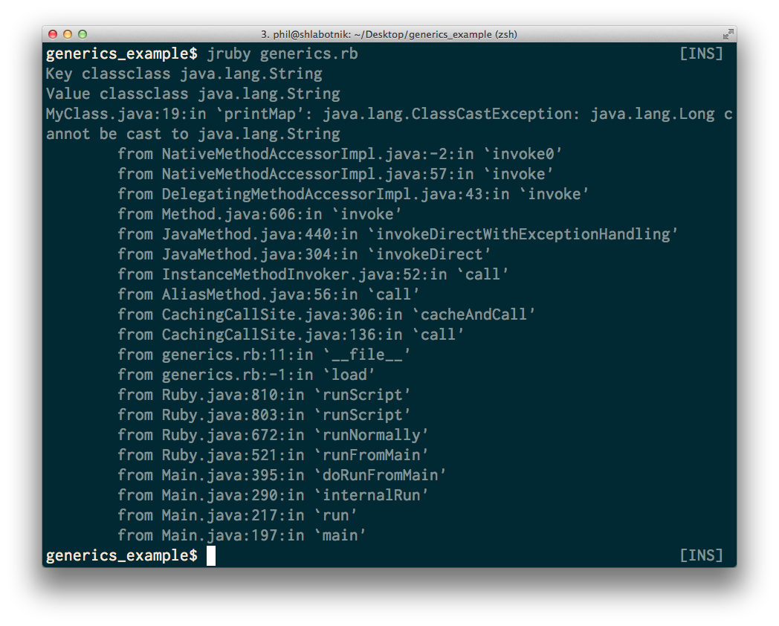
Notes:
This crashes because the types are erases during compile in java, so no way to determine the type in ruby
So no mapping it back
Can cause some nasty bugs!

Slide 48
Setting up sync

Slide 49
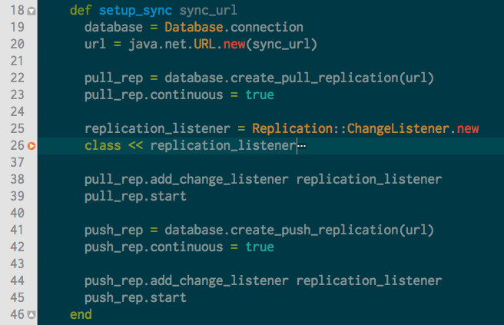
Notes:
Easy setup
We have already seen the monitoring
That will continuously replicate all the changes (this is configurabel)

Slide 50
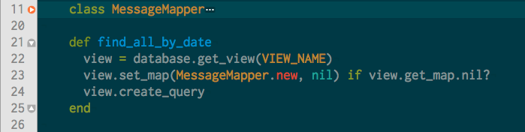
Querying Couchbase Lite
Notes:
- Create the query

Slide 51
Querying Couchbase Lite
Notes:
- Index by date so they are displayed right!

Slide 52
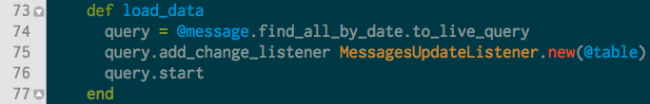
Querying Couchbase Lite
Notes:
Live query it, all changes will be listened to so we can display everything

Slide 53
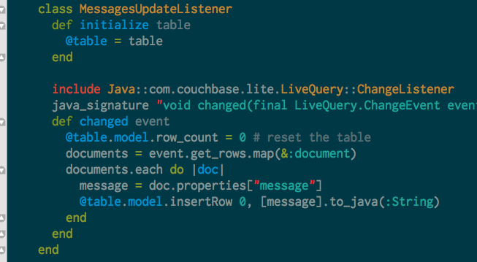
Querying Couchbase Lite
Notes:
Handle the display
Standart swing table
Make sure to convert the types!
DEMO Again!

Slide 54
Looking under the Hood
How JRuby is implemented

Slide 55
Hacking JRuby
Creating a method from Scratch

Slide 56
git clone https://github.com/jruby/jruby mvn -pBoostrap

Slide 57
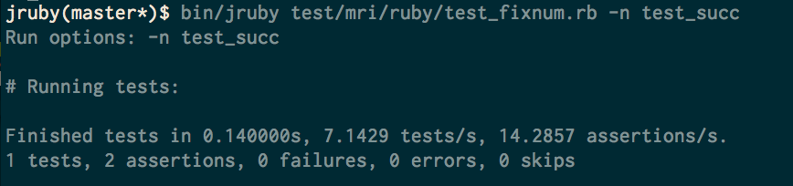
Running the tests
Notes:
Because we want to know it works

Slide 58
1.to_froscon # => “froscon”

Slide 59
Adding to RubyFixnum
Notes:
Let’s hack a small method in
Add test_foo to test_fixnum.rb
Implement in RubyFixnum
- mvn
- mvn -Pboostrap
- bin/jruby test/mri/ruby/test_fixnum.rb -n test_succ # as a sample test
- create a test for our to_foo method in test_fixnum.rb
- implement to_foo in RubyFixnum.java
- @JRubyMethod annotation to expose it to the world
- create new ruby objects in a given runtime
- getRuntime().newString(...) to create a ruby string
- mvn compile
- bin/jruby test/mri/ruby/test_fixnum.rb -n test_to_foo # as a sample test
- bin/jruby -e "puts 1.to_foo"

Slide 60


Couchbase Server 3.0 Beta Bug Bash Download, Find, Report, Win
DOWNLOAD Couchbase Server 3.0 Beta
Run some workload, play with it, FIND a bug
If you find a bug, REPORT it!
All bugs count – anything from correctness, to performance, to usability, to docs
WIN Prizes!!
http://www.couchbase.com/bugbash
Contest ends Aug 31st 2014

Slide 61
Questions?

Slide 62
Links
http://github.com/couchbaselabs/pi-on-couch
http://www.couchbase.com/communities
http://jruby.org

